Slide 1
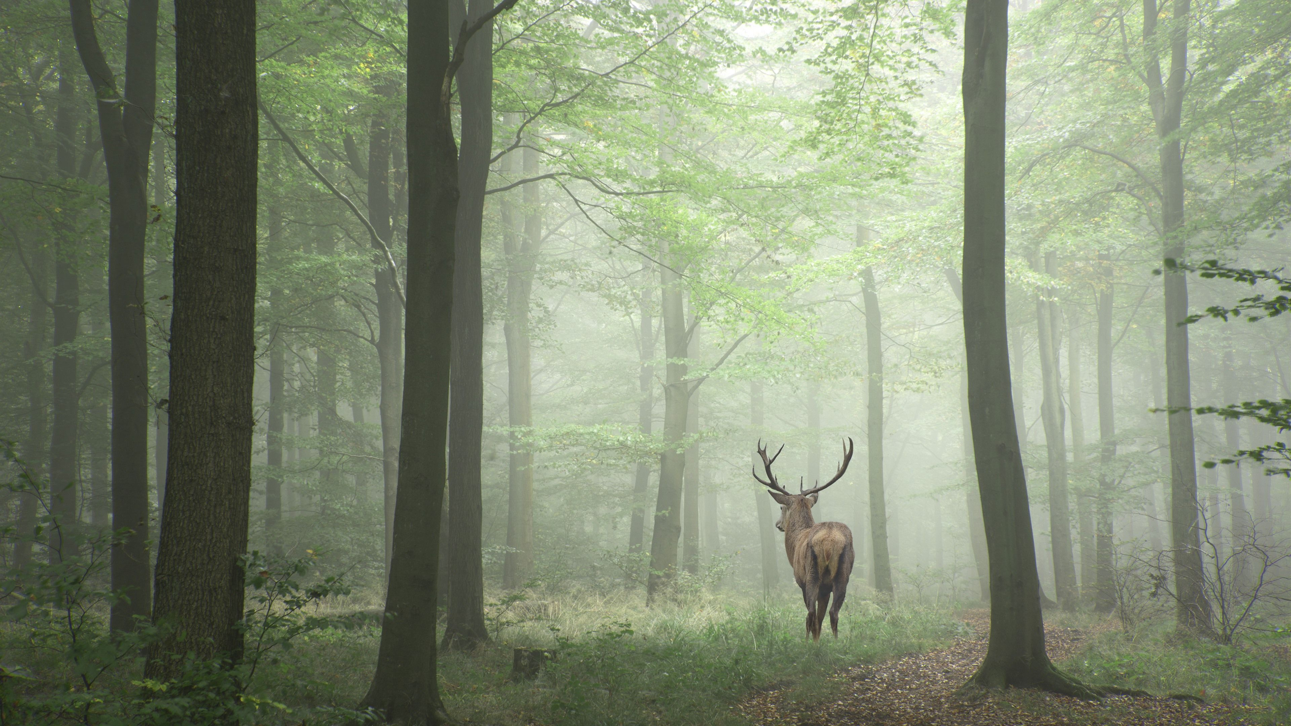
PLAY
OPTIONS
QUIT

Slide 2
START GAME
SETTINGS
QUIT

Slide 3




CONTINUE
OPTIONS
LEAVE GAME

Slide 4
CONTINUE
OPTIONS
LEAVE GAME

Slide 5

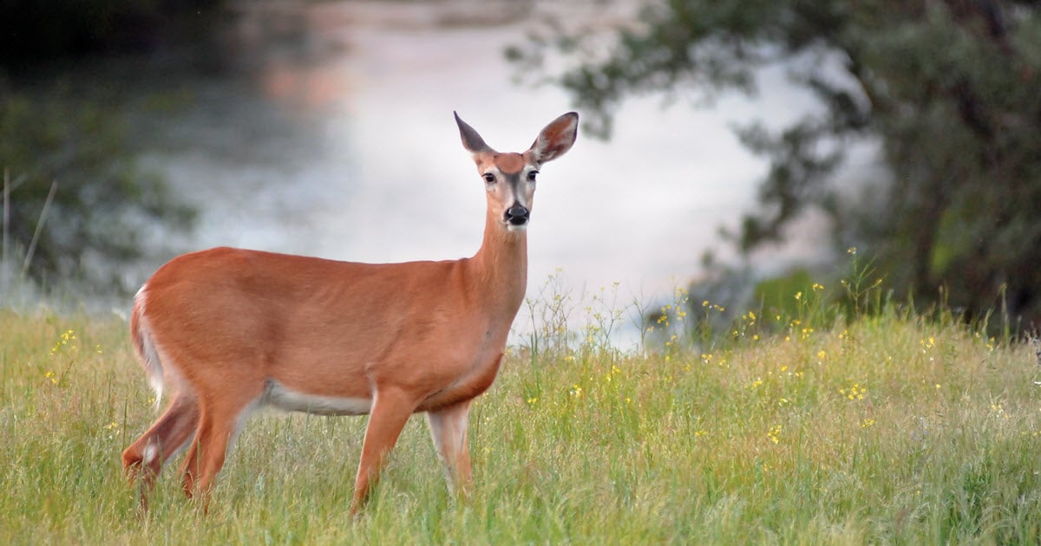
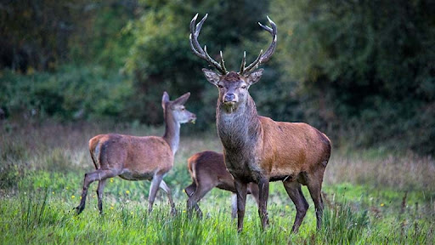



They are members of the Bovidae, which are also known as permanently horned antelopes. They are not related to the ruminant family Ruminantia. The common ancestor of these animals is the chevrotain, which is also known as the musk deer. They have played a significant role in art, literature, and religion.
WILDLIFE NOTEBOOK
Deer
Educational Video
Start Quiz
Deer are members of the Cervidae family. There are two main groups of deer, the Cervinae and the Capreolinae. They are both hoofed ruminant mammals. They are members of the Bovidae, which are also known as permanently horned antelopes. They are not related to the ruminant family Ruminantia. The common ancestor of these animals is the chevrotain, which is also known as the musk deer. They have played a significant role in art, literature, and religion.
ADD ANIMAL

Slide 6
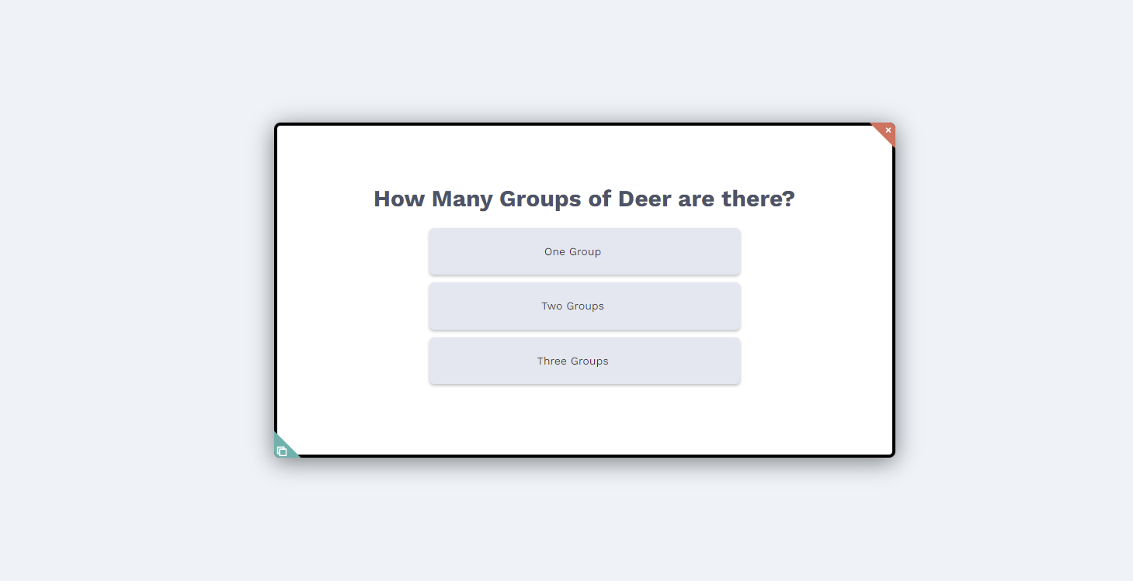
QUIZ

Slide 7
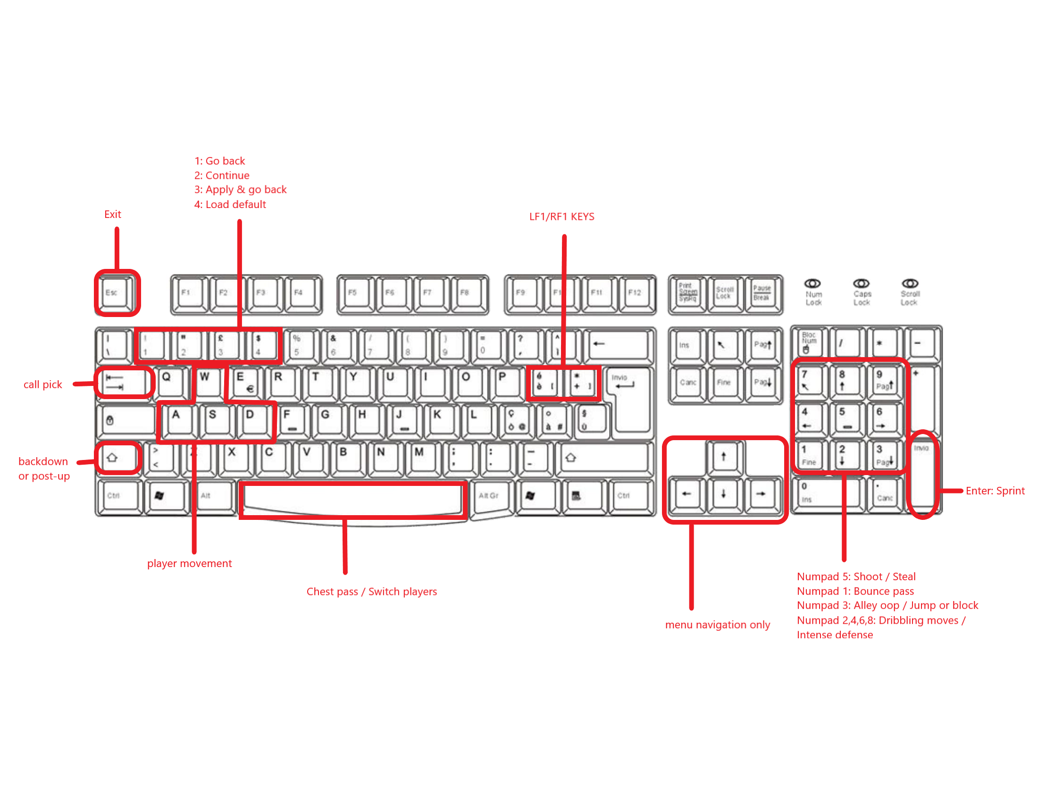
CONTROLS

Slide 8
SETTINGS
VOLUME
CONTROLS

Slide 9

LOADING…

Slide 10


VOLUME

Slide 11


E

